Slide 1
PROJECT EXPO
Digital Error Detection System Using Parity
A first-year digital logic demonstration
B.Tech 1st Year · [Section-9]
Guna — 2620030324
Yashaswini — 2620030276
Srija — 2620030323
Akshita — 2620030329
Notes:
Introduce the project as a working demonstration of how parity detects errors in digital data. The team will show the logic, the checker, and a live bit-flip test.

Slide 2
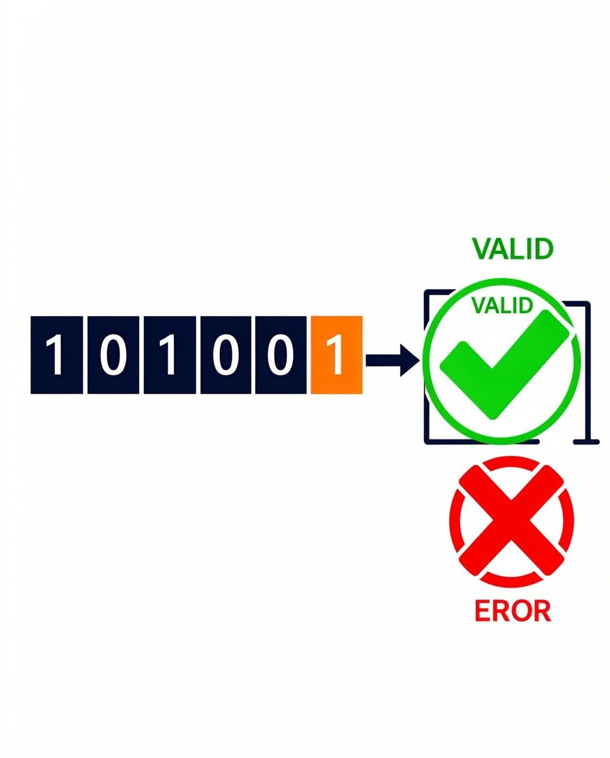
02
INTRODUCTION AND OBJECTIVE
02 · OVERVIEW
Why binary data needs error detection
Digital systems move data as strings of 0s and 1s across wires and networks. A single flipped bit can change a value with no visible sign, so the receiver needs a fast way to notice damage.
Introduction
Objective
This project builds a small digital circuit that adds one parity bit to each data word and checks it at the receiver.
Design, simulate and demonstrate a parity-based system that detects single-bit errors in transmitted binary data.
Notes:
Explain that digital data can be corrupted in transit. The project adds one parity bit and checks it at the receiver, so a single-bit error becomes visible.

Slide 3

03
THEORY AND LOGIC CIRCUIT
03 · PARITY
Theory and logic circuit
A parity bit is one extra bit added to binary data so the number of 1s follows a fixed rule.
EVEN PARITY
ODD PARITY
Total 1s must be even. Data 1011 has three 1s, so P = 1; codeword 10111.
Total 1s must be odd. Data 1011 gives P = 0; codeword 10110.
XOR gate
NOT gate
Outputs 1 when its inputs differ. Builds the parity bit and the checker.
Flips a bit: 0 becomes 1 and 1 becomes 0.
Logic circuit: data bits feed an XOR cascade that produces P; the checker XORs all received bits with P.
Notes:
A parity bit is one extra bit added to binary data. With even parity, data 1011 has three 1s, so P = 1 and the codeword is 10111. Odd parity uses the opposite rule. XOR builds the parity and checks it; NOT provides the complementary signal.

Slide 4
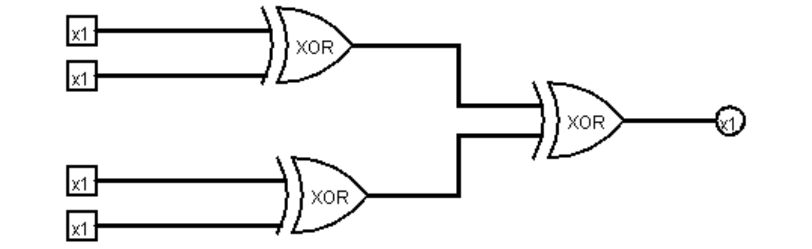
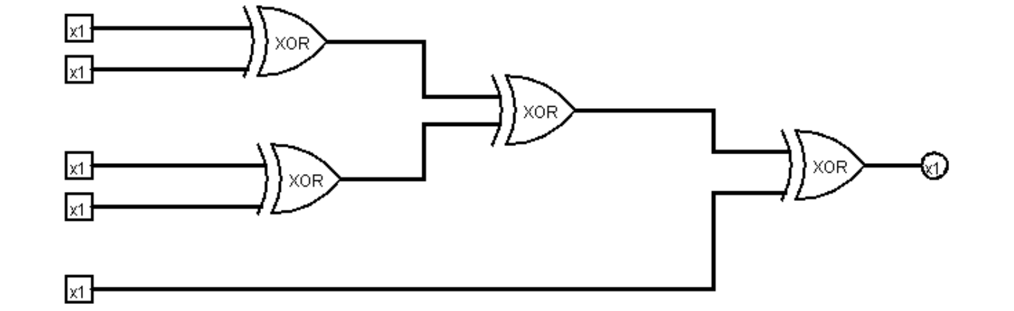
04
CIRCUIT DESIGN
04 · LOGISIM
Circuit design in Logisim
Figure A · Parity generator: XOR cascade of data bits produces parity P.
Figure B · Parity checker: XOR of data bits and received P. 0 = VALID, 1 = ERROR.
Input pins
XOR cascade
Data bits A–D enter the circuit; the transmitted parity bit enters the checker.
Gates combine the bits one stage at a time into a single signal.
Parity output
Checker output
The generator output P is appended to the data to form the codeword.
0 shows VALID; 1 shows ERROR on the indicator.
Notes:
Walk through Figure A from the input pins through the XOR cascade to parity output P. Then show Figure B: the checker repeats the XOR over all received bits and shows VALID or ERROR.

Slide 5
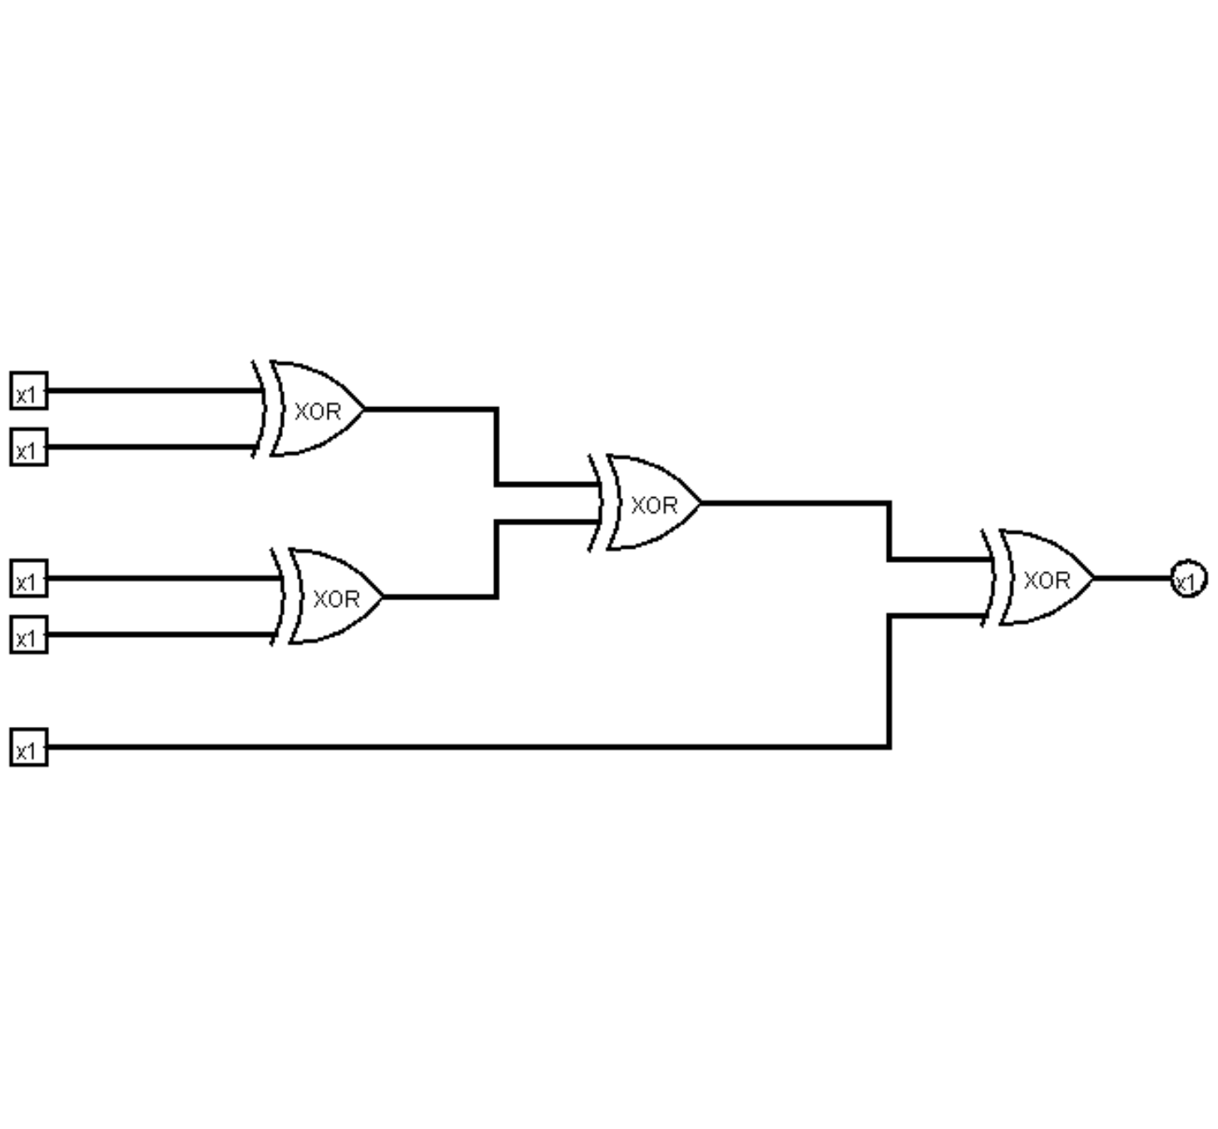
05
SIMULATION RESULTS
05 · TRUTH TABLE
Simulation results
Data A–D | Parity P | Checker
0000 | 0 | VALID
0001 | 1 | VALID
0011 | 0 | VALID
0111 | 1 | VALID
1111 | 0 | VALID
0011 + flipped P | 1 received | ERROR
Error case: one transmitted bit flipped, so the checker output is 1.
Checker simulation: output 0 = VALID, output 1 = ERROR.
Notes:
Read the table: 0000 gives P0, 0001 gives P1, 0011 gives P0, 0111 gives P1, and 1111 gives P0. When one transmitted bit is flipped, the checker output becomes 1 and shows ERROR.

Slide 6
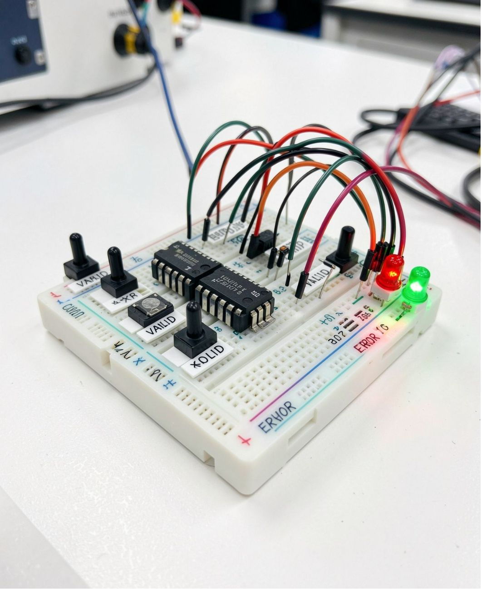
06
CONCLUSION
06 · APPLICATIONS
Conclusion and applications
Outcome
Applications
The parity generator and checker detect every single-bit error in the demonstrated cases.
Communication systems and digital data transmission, where cheap error checks protect data.
Limitations
Future improvements
Parity detects but cannot correct the wrong bit, and misses some multi-bit errors.
Stronger error-detecting codes such as CRC, and error-correcting codes such as Hamming.
Team: Guna • Yashaswini • Srija • Akshita
Thank you
COMPLETED PROTOTYPE · PARITY CHECKER
Notes:
Summarize the outcome: parity detects single-bit errors with low cost. Name the applications in communication and digital data transmission. Be clear about the limits, and point to stronger error-detecting and error-correcting codes as future work.

